Slide 1




Article 29: Education must develop every child’s personality, talents and abilities to the full.

Slide 2


S3 Social Subjects
Geography
History
Modern Studies
Notes:
Introduction. Mention the other subjects in the faculty but explain that they cannot ‘pick up’ a new subject – they have to continue with 7 of the 9 they are currently studying.

Slide 3


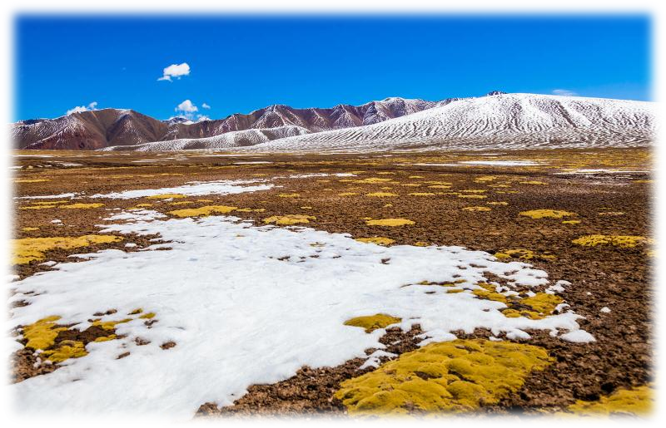
S3 Geography
In S3 Geography, we will learn about the following topics:
Tourism
Types of tourism
Popular destinations
Impacts of tourism
Theme park and space tourism
Glaciation
Features in glaciated landscapes
Land use
Land use conflicts
Field trip to Corrie Fee
Rainforests
Location and climate
Animals and plants
People in the rainforest
Destruction of the rainforest
Later on in the year, we will start looking at National 4/5 Geography units, including Malaria

Slide 4
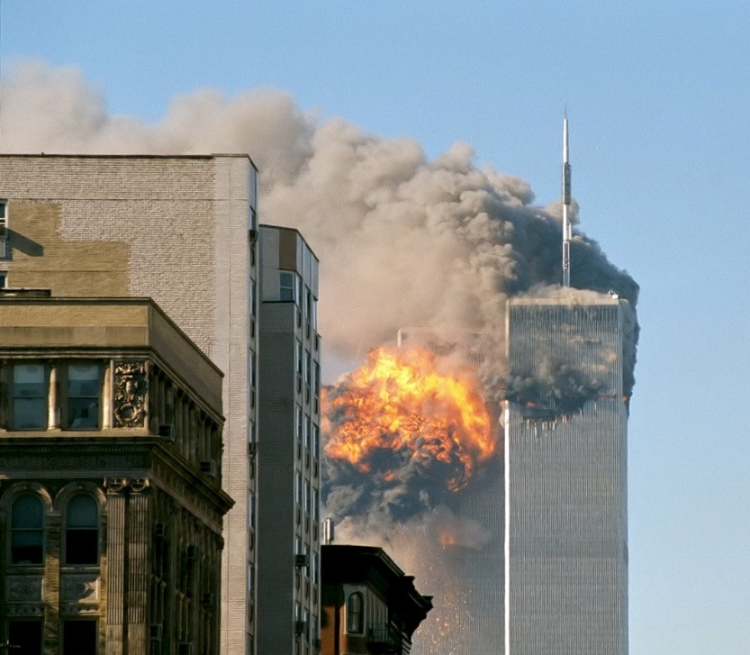



S3 Modern Studies
In S3 Modern Studies, we will learn about the following topics:
Crime and Law- In this unit, we will learn about:
Categories of Crime
Causes of crime
Courts
Prisons advantages and disadvantages
Non Custodial sentences
Role and Powers of the Police
Effectiveness of the Police in Scotland
USA - In this unit, we will learn about:
Ethnic Groups
Push and Pull
Immigration
Rights, Participation and the Media
American Dream V American Reality
KKK and Black Lives Matters
Gun control
Mass Shootings
Terrorism - In this unit, we will learn about:
the History of terrorism
Causes and Consequences of terrorism
Counter terrorism
China (World Power) - In this unit, we will learn about:
China’s Economic, Political and Military influence
the Chinese language and traditions
the Political System of China
Social issues in China (censorship of the internet, CCTV, the media in China compared to the UK, religious freedom, crime and population)
During the year, we will start work towards National 4/5 skills.

Slide 5
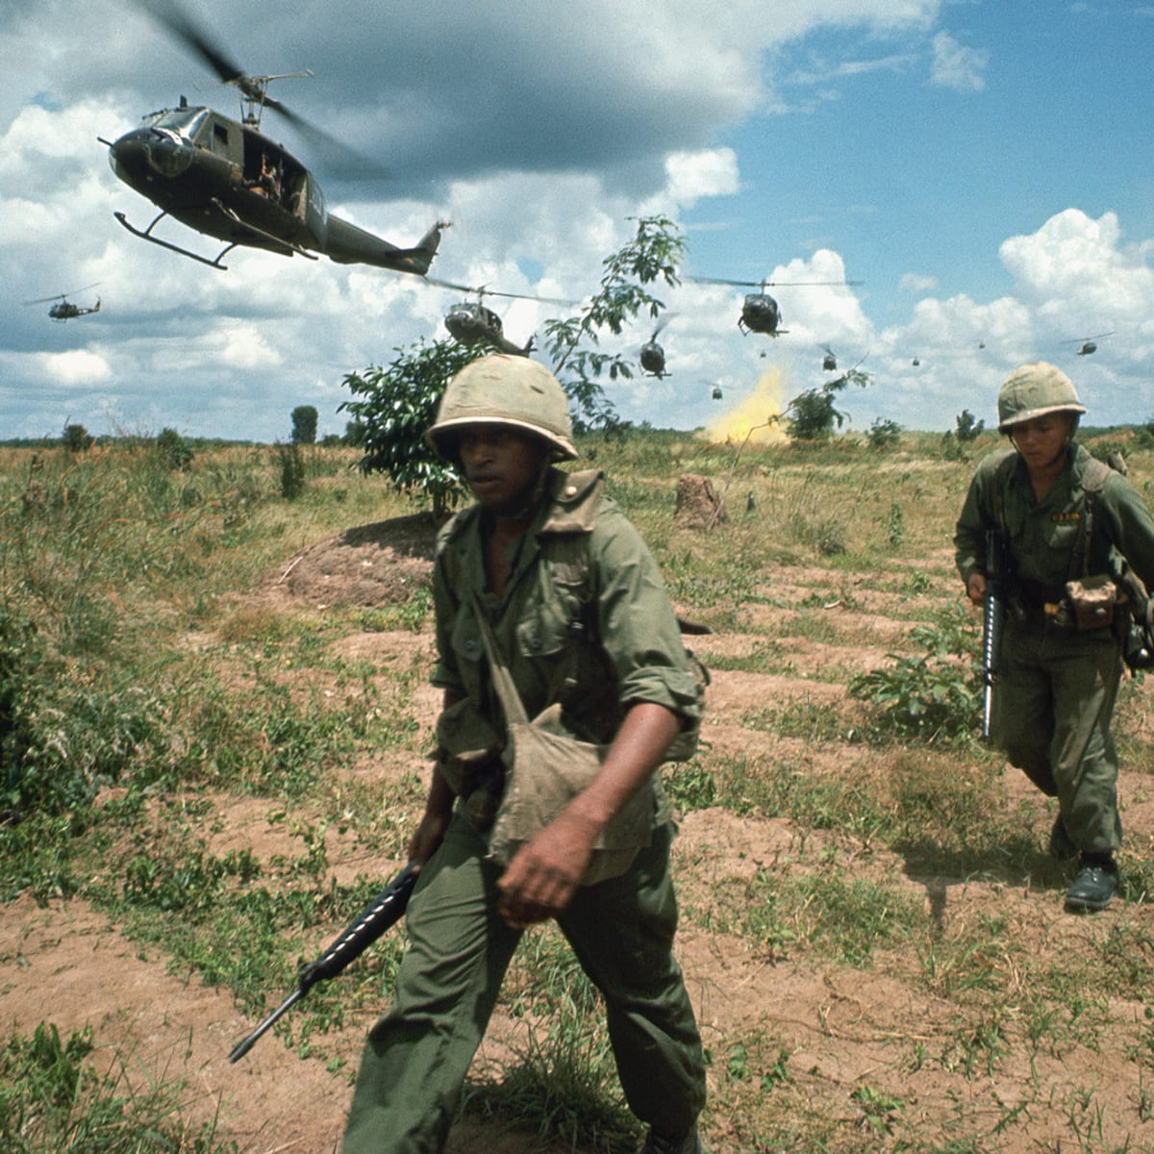

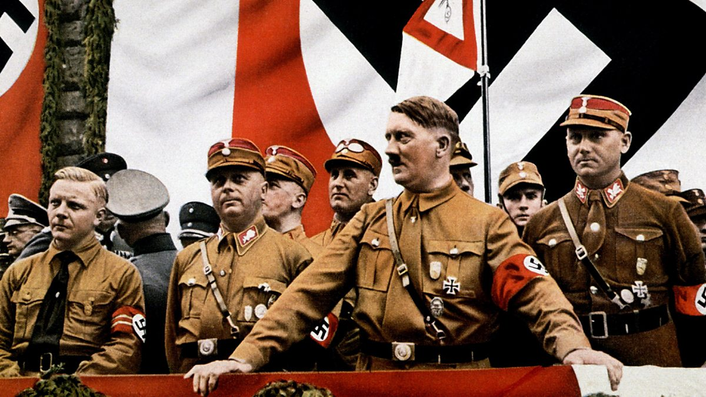
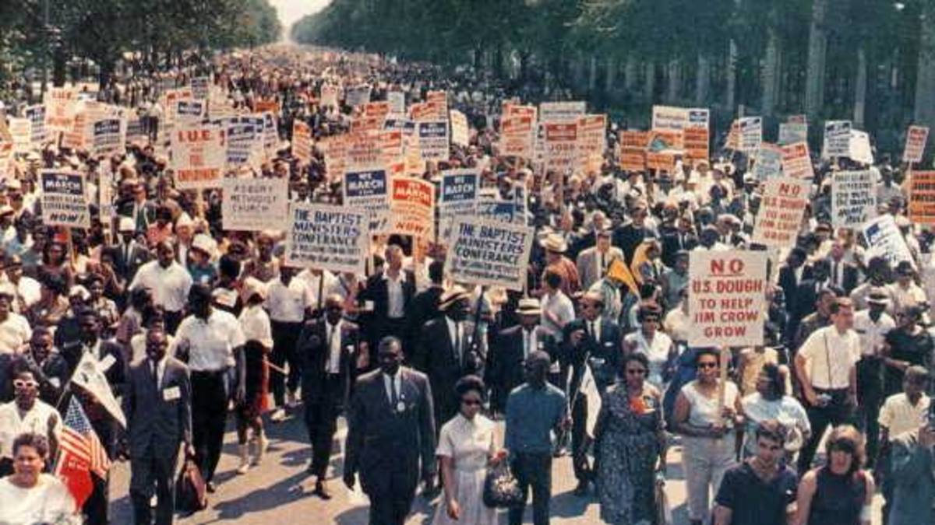

S3 History
In S3 History, we will learn about the following topics:
Civil Rights In this unit, we will learn about:
Black Lives Matter – George Floyd
Jim Crow Laws
The KKK then and now
Civil rights movements in the 1950s and 60s
Hitler and Nazi Germany In this unit, we will learn about:
The rise of Hitler and The Nazis
The Nazi party in power
The Holocaust
Vietnam In this unit, we will learn about:
Vietnam and the cold war
USA tactics
Vietcong
MafiaIn this unit, we will learn about:
Life in Italy
Immigration to America
Prohibition and Al Capone
Mafia today
Later on in the year, we will start work towards National 4/5 History starting with the Atlantic Slave Trade unit.

Slide 6

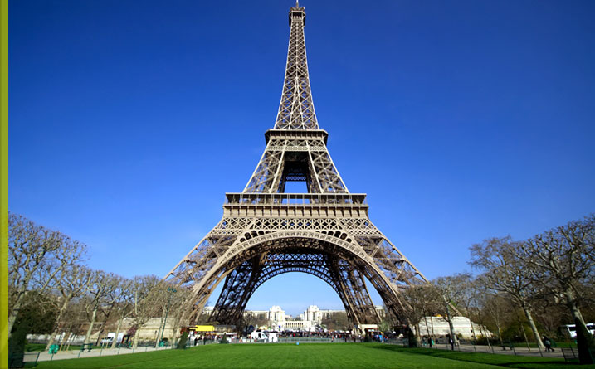


Languages Faculty
Webster’s High School

Slide 7








N4/N5
Level
Contexts
Society
Lifestyle
Citizenship
Global languages
Media – new technologies
Employability
Skills and Qualities
Work Experience
Job applications
Learning
Comparing education systems
Exam Preparation
Best ways to learn a language
Culture
Travel
Traditions/festivals
History/politics
Film/ art / Literature
25%
25%
25%
25%

Slide 8


Slide 9


S3 Sciences
Biology
Chemistry
Physics
Notes:
Introduction. Mention the other subjects in the faculty but explain that they cannot ‘pick up’ a new subject – they have to continue with 7 of the 9 they are currently studying.

Slide 10


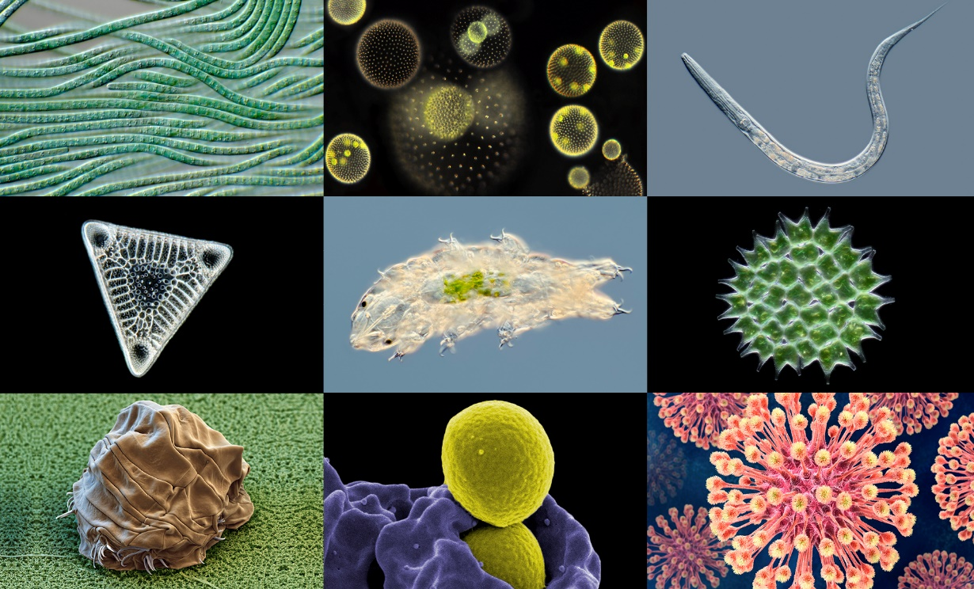




S3 Biology Course
S3 Before Christmas
S3 After Christmas

Slide 11
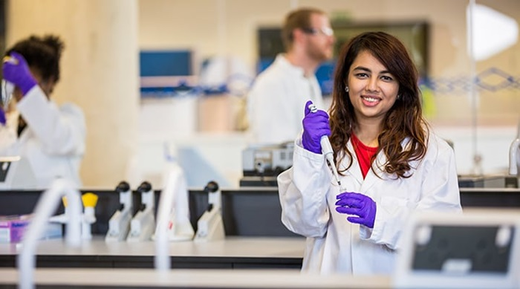
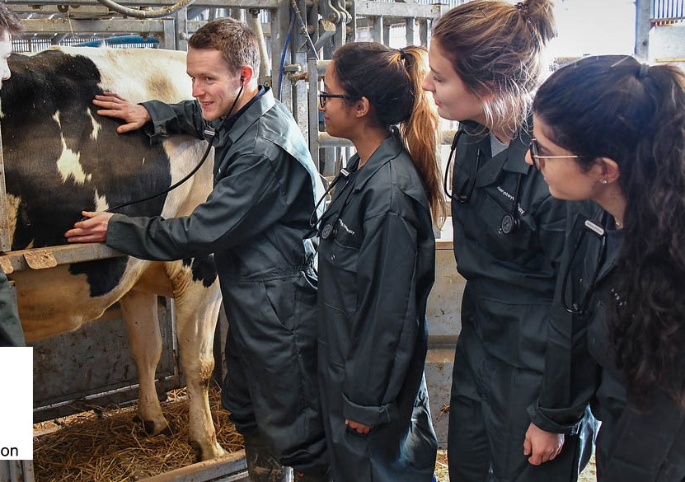
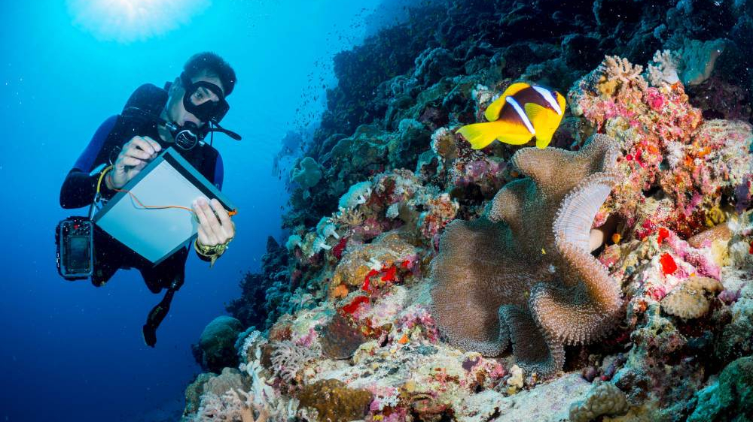
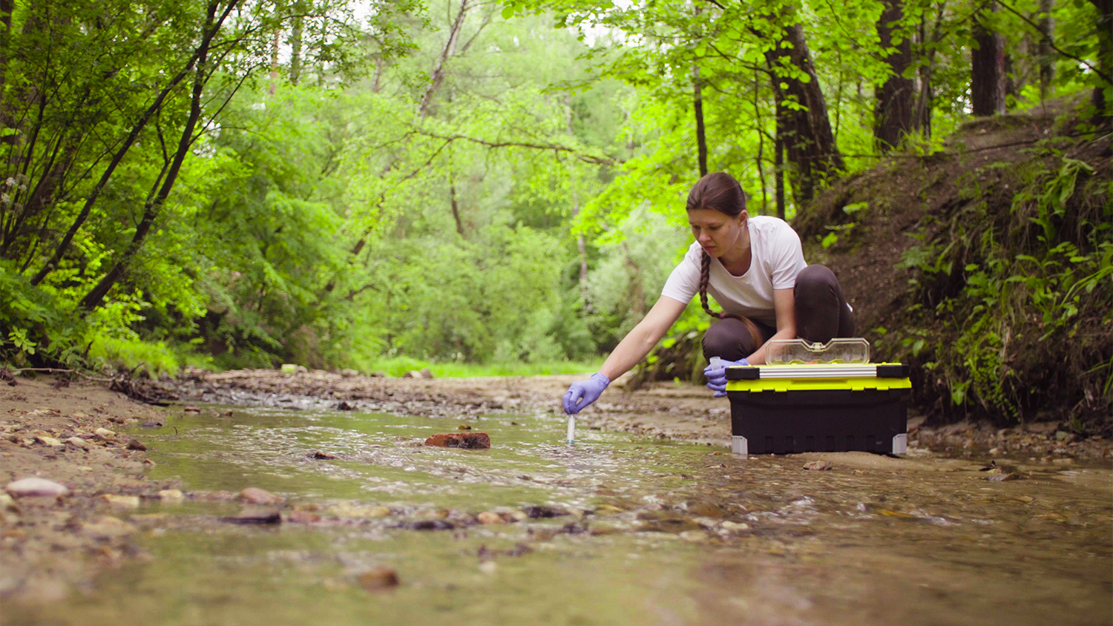


Biology Careers

Slide 12





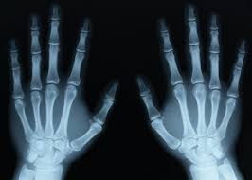



S3 Before Christmas
S3 After Christmas

Slide 13


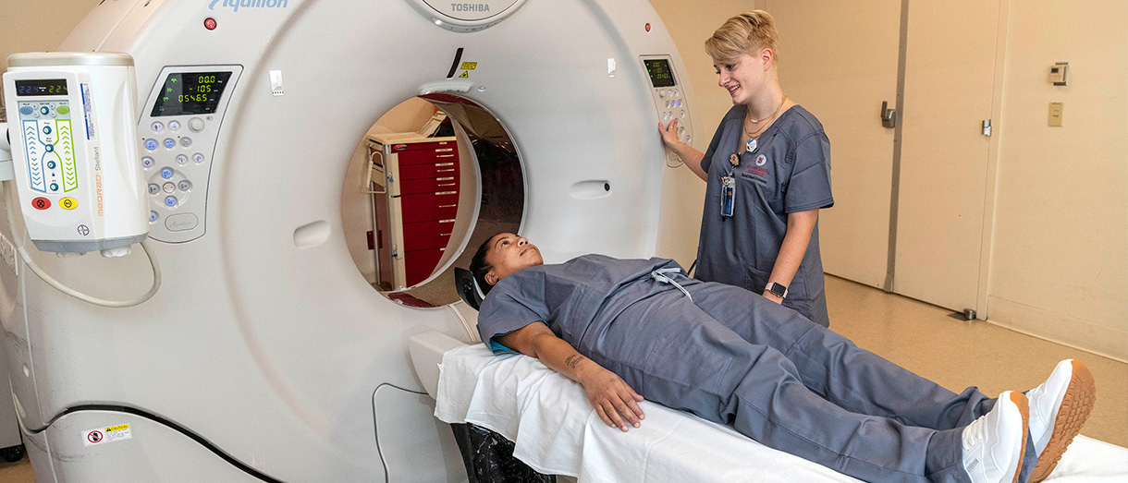






Slide 14
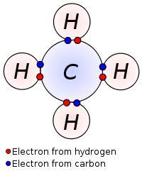
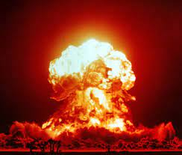
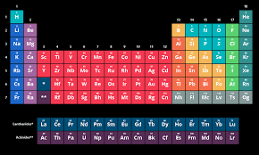

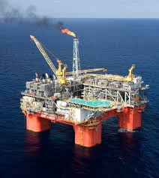

S3 Chemistry Course

Slide 15
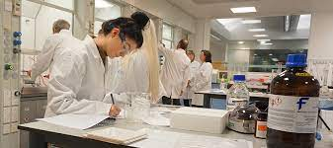
Chemistry Careers

Slide 16




Physical Education
S3 Elective Presentation

Slide 17
What is Elective PE
Elective PE prepares you to take National 5 PE in S4
You get 3 periods a week of Elective PE
You still get core PE
You will do 1 theory period every 2nd week.

Slide 18
What do I do after Elective
S3 Elective
National Progression Award (NPA)
National 5 PE
Higher PE

Slide 19
‘What activities do we do?’
Athletics
Badminton
Basketball
Handball
Hockey
Gymnastics
Swimming
Table tennis

Slide 20
What we expect from you
You bring PE kit for every lesson
You take part in every lesson
You must swim during S3 elective PE
You have to complete written work by deadlines set

Slide 21
Potential Careers with PE
Athlete
Events manager
Exercise Physiologist
Health trainer
Leisure centre manager
Lifeguard
Military Services
Nutritionist
Outdoor Activities Instructor
PE teacher
Personal trainer
Physiotherapist
Play Therapist
Police Officer
Primary school teacher
Referee
Sports and Exercise Psychologist
Sports Agent
Sports Coach
Sports Commentator
Sports Development Officer
Sports Physiotherapist
Sports Scientist

Slide 22

S3
Rural Skills

