Slide 1




Article 29: Education must develop every child’s personality, talents and abilities to the full.

Slide 2
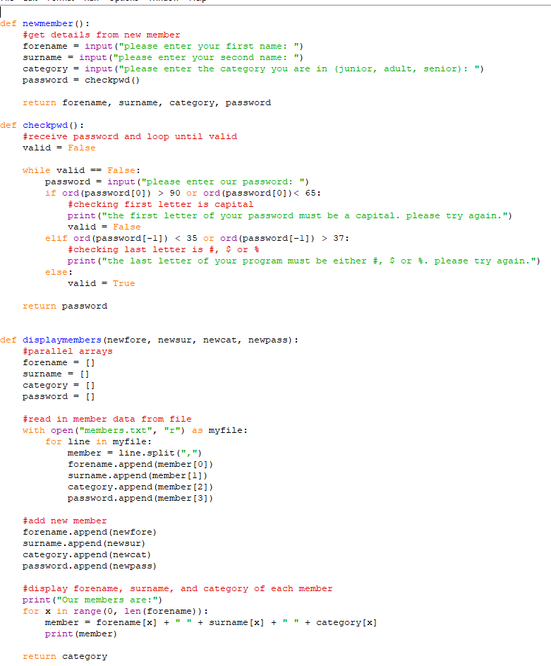
Computing Science
What do you do?
A LOT OF PROGRAMMING
Websites, Databases, Python
A LOT OF THEORY
How do computers actually work?
How do we get from 0’s and 1’s to data on our screens
How is software developed?

Slide 3
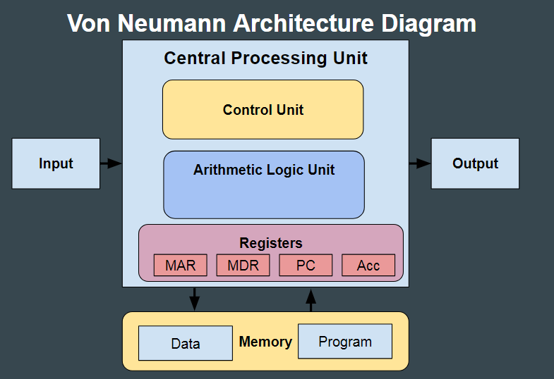
Computer SYSTEMS

Slide 4
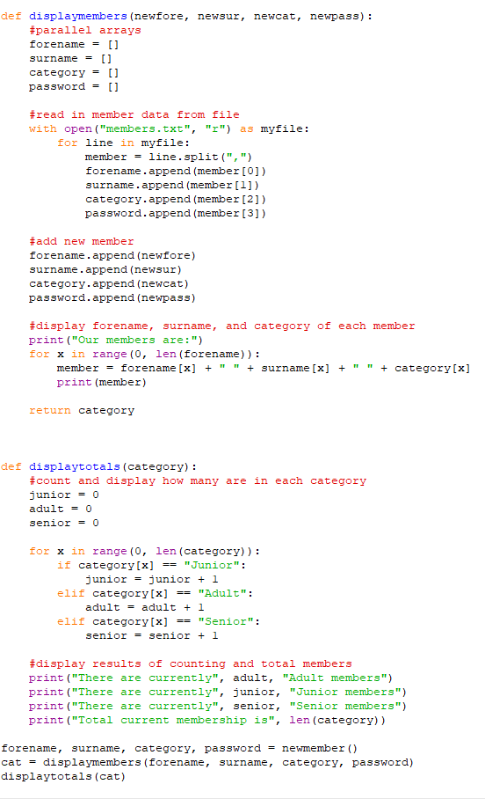
Software design and Development

Slide 5
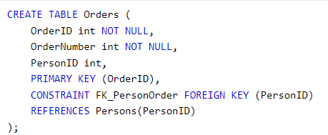


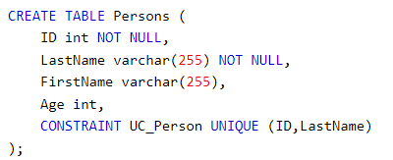

Database design and Development

Slide 6


Web design and development

Slide 7
Assessments
30% of your final grade is a practical coursework task that lasts 8 hours
70% of your grade is a 2 hour exam
Why should you pick this subject?
If you enjoy Mathematics, Engineering, Physics/Chemistry
If you want to learn the theory about why a computer works, not just how to use them
If you want to challenge yourself

Slide 8

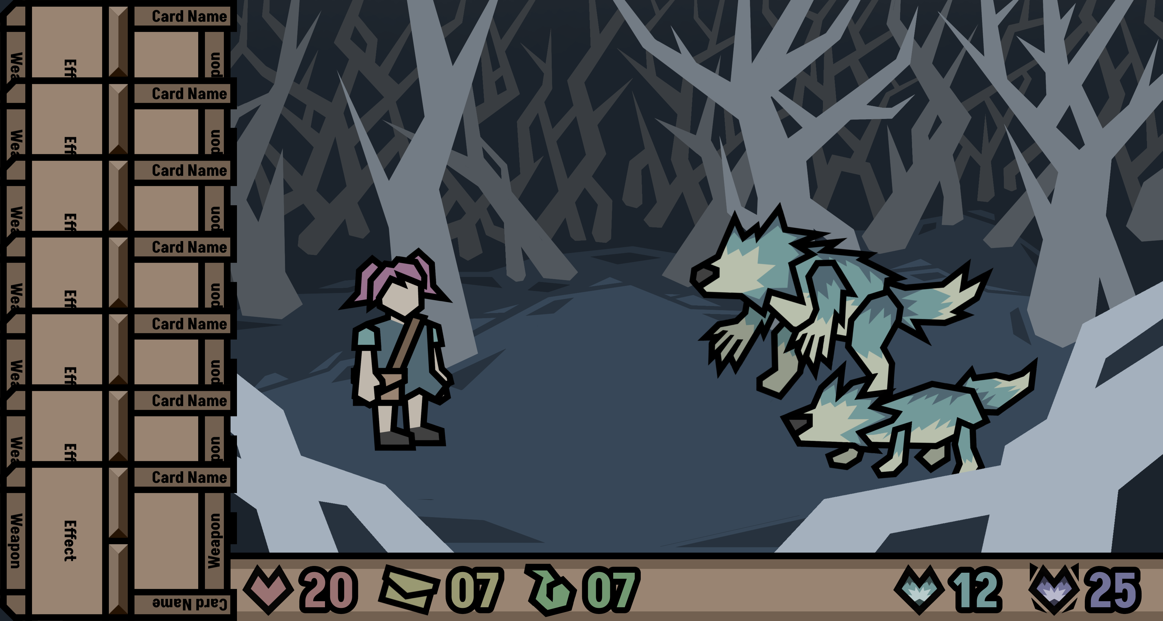

Games Design and Development
All about designing and building a game from the ground up
Equivalent to a Higher
Can only pick in S5+ but must have completed at least N5 Computing beforehand

Slide 9
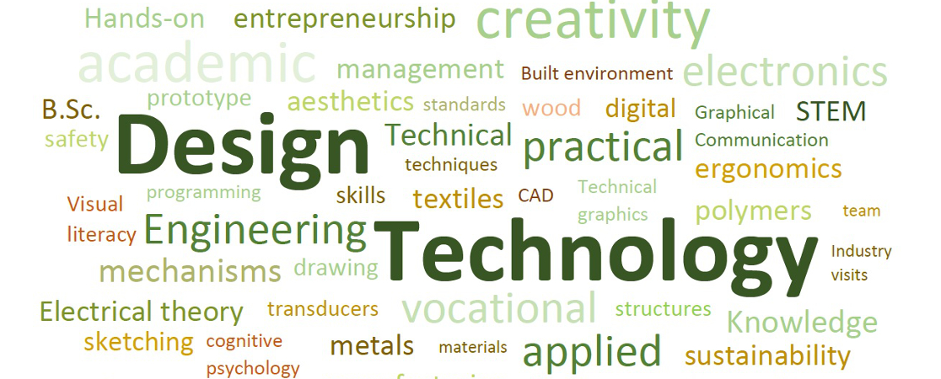

Slide 10

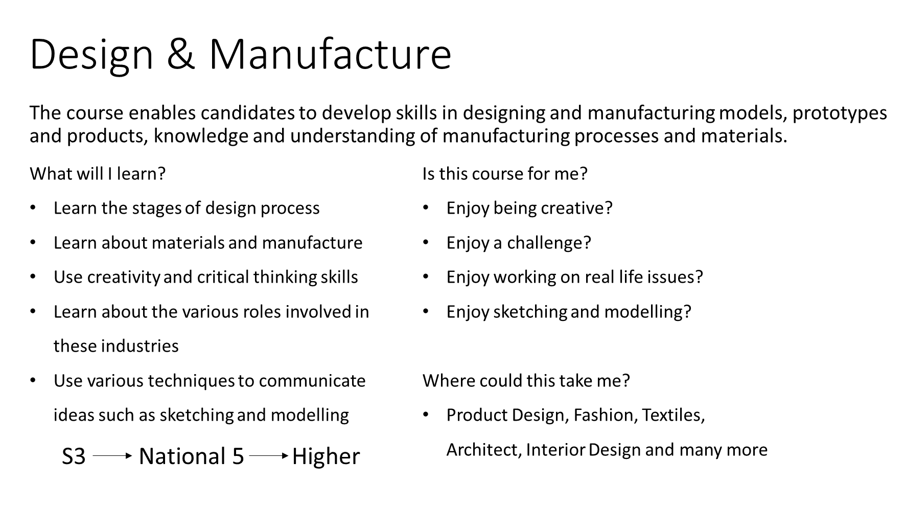

Slide 11
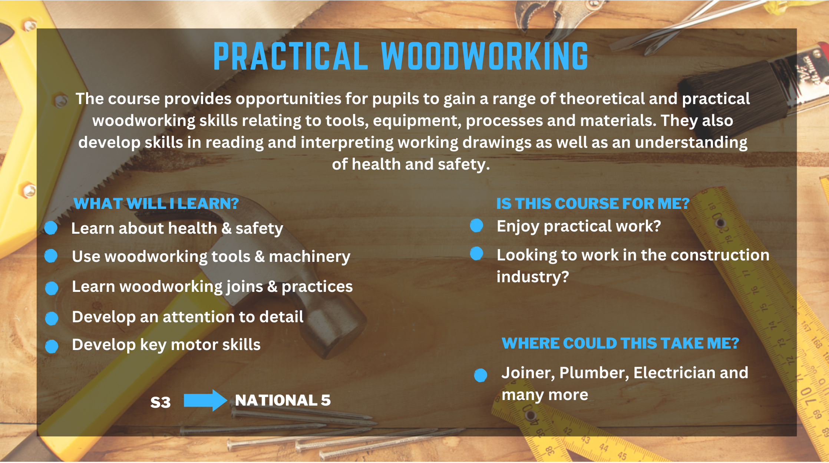

Slide 12


Slide 13



Art
Photography
Drama
Music
Music Technology

Slide 14


Slide 15


Slide 16
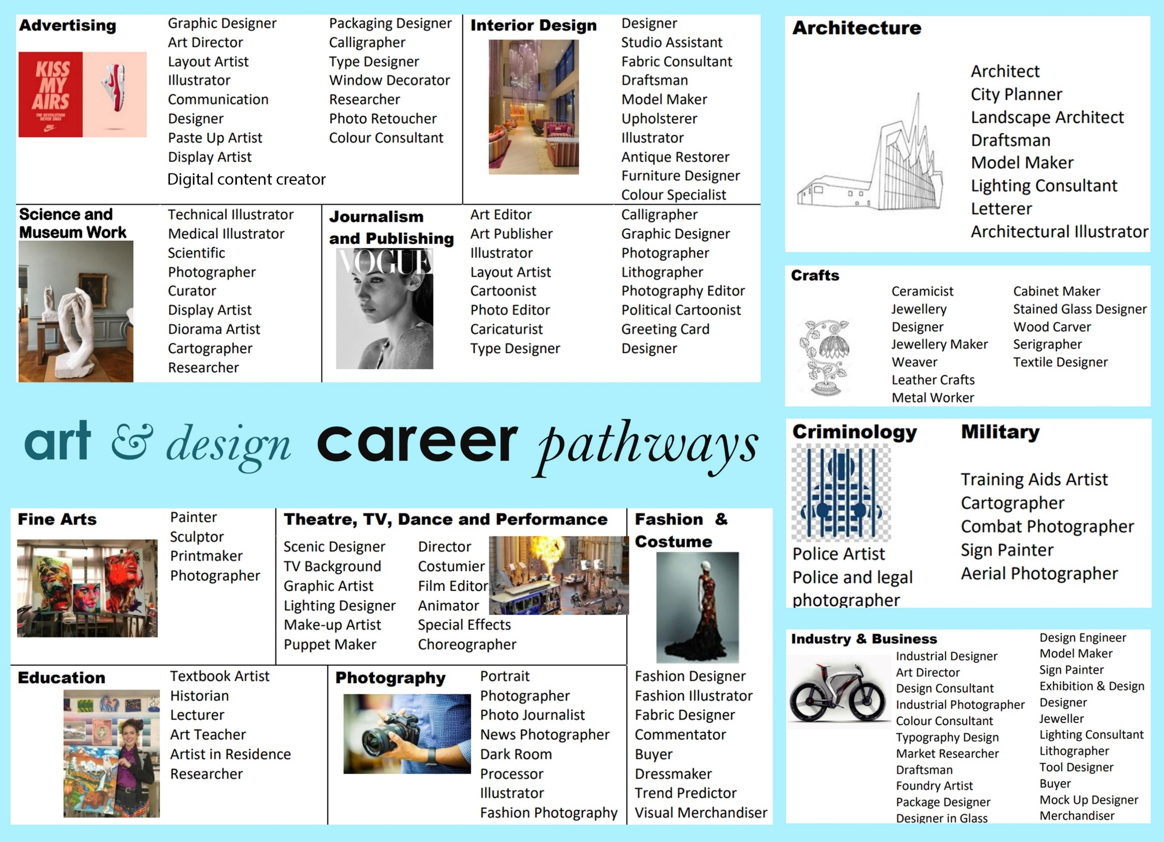

Slide 17



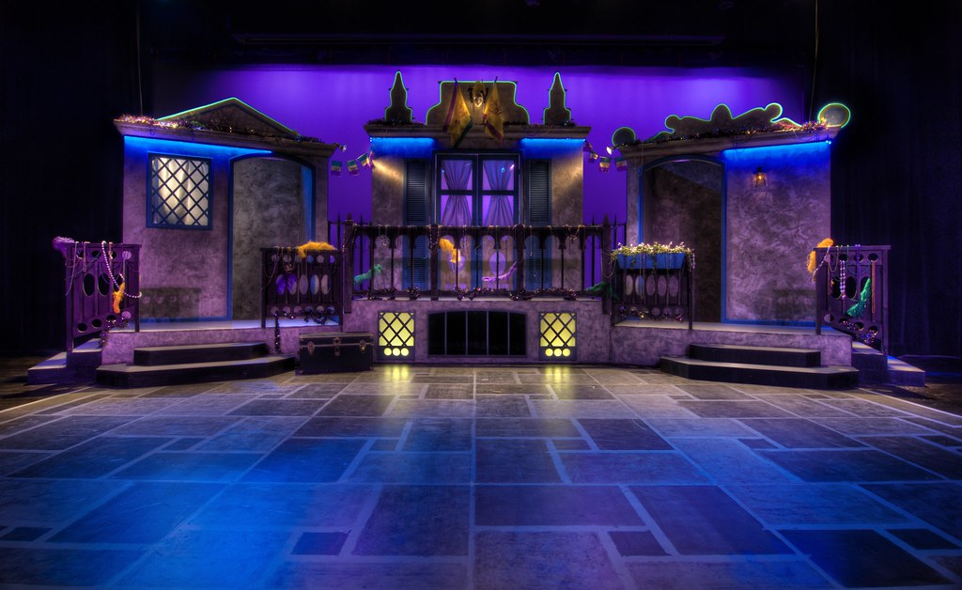
Drama
  3 periods each week
LOADS of practical work!
Lots of voice work, movement work, taking on a range of different characters
You can be assessed as an Actor, Lighting Operator, Sound Operator, Set Designer, Costume Designer, Prop Maker or Hair & Make-up Artist
Devised and script-based
Speak to someone in S3 who already studies the course for an honest review!

Slide 18

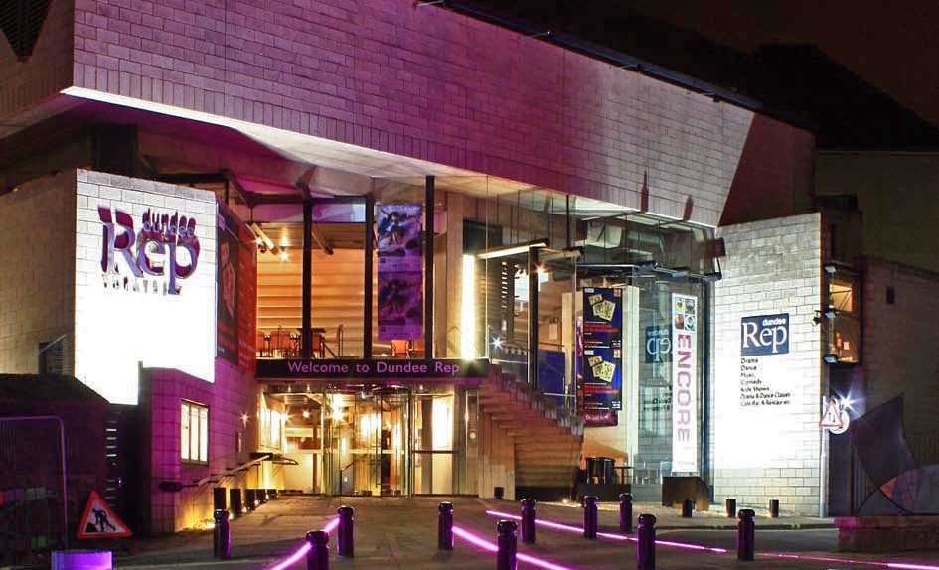
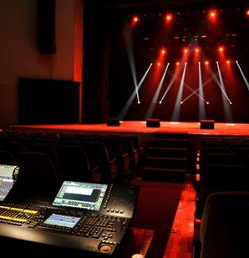

Progression & Career Pathways…
  S3 Drama leads to…
  N4 / N5 Drama leads to…
Higher / Advanced Higher Drama…
Could lead to studying Drama / Technical Theatre / Musical Theatre
OR…
Drama will help provide you with excellent skills for ANY course or job in the future:
Marketing
Content Creator
Events Management
Costume Design
Publishing
Computer Games Development
Teaching English Abroad
Drama will also help you in any job where you present information to colleagues plus it will give you confidence in interview situations to help you land your dream job!

Slide 19


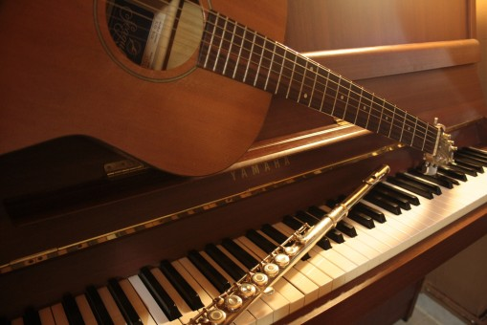
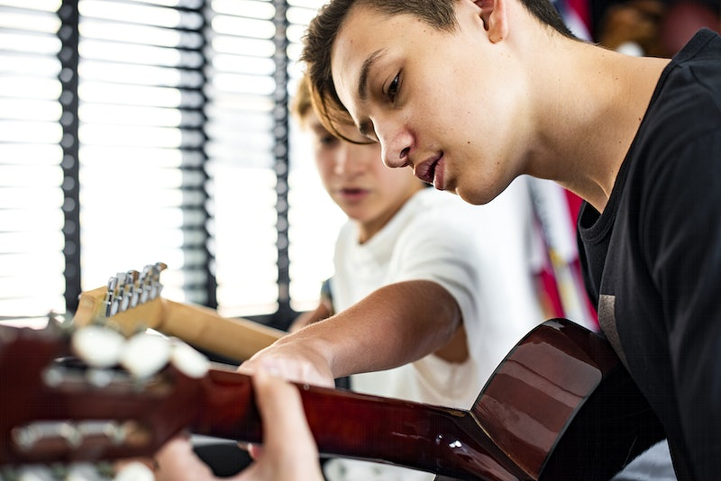

Music
  3 periods each week
Lots of practical work!
2 periods of skill-building on 2 instruments/voice
  Choice of instrument(s)
  Can also choose voice
  Choice of piece(s)
1 period developing ‘Listening’ and ‘Music appreciation‘
  Popular Music Styles
  Jazz Music Styles
  World Music Styles
Opportunities for group and solo performance work
Opportunities to use music technology to explore 'Composition' skills

Slide 20


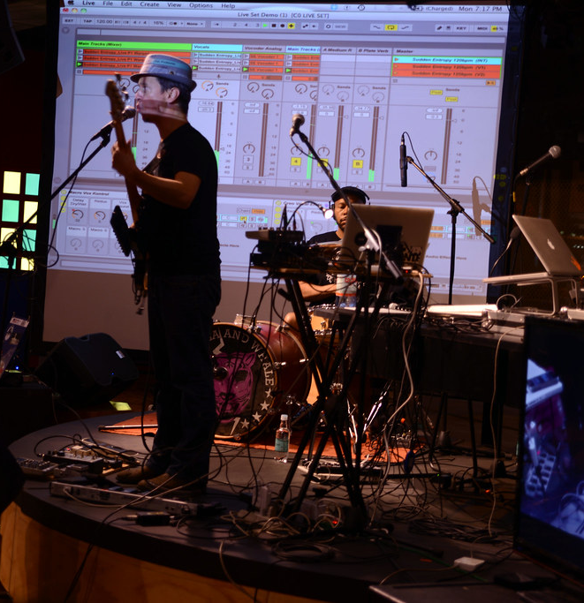

Music Technology
  3 periods each week
Lots of practical work!
Learn about recording techniques
Use Ableton to develop editing and mixing techniques learnt in S1/S2
Explore 20th and 21st century styles:
  Jazz
  Rock’n’roll
  Rap
  Synth pop
  Punk
  Dance music
Create different projects:
  Soundtrack for film/computer game
  Radio broadcast
  Audiobook
  Composition – create your own song – could count towards Music coursework!

Slide 21
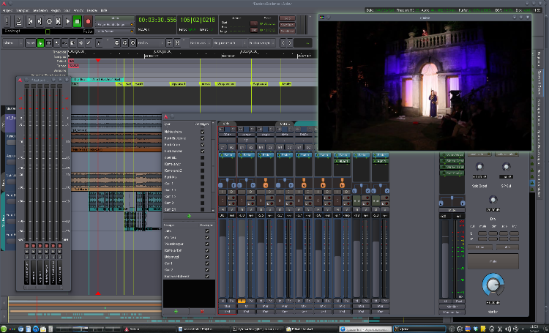




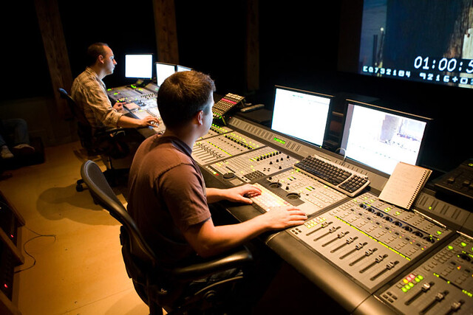
Progression &
Career Pathways…
S3 Music leads to....
N4/5 Music or Music Technology leads to...
Higher Music or Higher Music Technology leads to….
Advanced Higher Music, Music Leadership Awards
Beyond school
Many Scottish colleges/Universities offer Music courses from certificate to degree level. eg. Perth Campus (UHI) offer
  Performance
  Sound Production
  Musical Theatre
Music and Music Technology will help you to develop skills such as leadership, collaboration, communication and creativity. These will be useful for many different jobs including those in within music such as:
Sound engineer or sound designer
Broadcaster
Teacher
Music Therapist
Arts administrator
Events & festival management

Slide 22
Home Economics
Course Choice Information

Slide 23
What do we offer in S3
Practical Cookery – Starting at National 3 and continuing onto National 4/5
Early Learning and Childcare – Starting at National 4 and continuing onto National 5/Higher

Slide 24
Practical Cookery
REHIS Certificate – Food Safety and Hygiene certificate
More Practical lessons weekly to allow for skill development
Theory lessons to enhance knowledge of the subject, including sustainability within food production from Farm to Fork.
Hoping to introduce guest speakers to class to further skills and knowledge and opportunities within world of Work

Slide 25
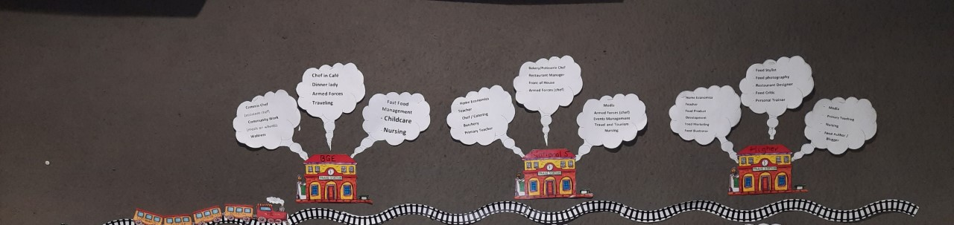
My World of Work

Slide 26
Early Learning and Childcare (Nat 4)
4 units
Child Development
Discovering the 4 areas in which children develop
(Physical, Social & Emotional, Cognitive, Linguistic)
Play in Early Learning and Childcare
Researching and discovering how ‘Play’ helps the development of children
Working in Early Learning and Childcare
Gaining experience within a childcare setting
Care of Children
Researching how to care for children (feeding, changing, physical, emotional, social etc)

Slide 27
Progression in Early Learning and Childcare
Opportunities within the course
Work experience within a local nursery/playgroup/primary
Working with local organisations (BookBug)
Provide termly Playgroup Sessions for local children/families
Qualifications
National 5
Higher
Careers/Pathways
Childcare
Nursery practitioner / teacher
Primary/Secondary school teacher
Paediatric nursing
Travelling (while caring for children)

Slide 28
Further Information
Please feel free to speak to any of the Home economics teachers at any time to help with further information on a course you may be interested in. We are always happy to help.

